Slide 1
ENHANCED DIABETIC RETINOPATHY CLASSIFICATION WITH MULTI POINT ATTENTION AND SEMI SUPERVISED LEARNING
PROJECT STAGE-II REVIEW-I
15.02.2025
Under the Guidance
Presentation by
Mrs. M. Anusha
Vinitha Kandula (21C11A05J0)
Assistant Professor,
Department of CSE
Srilekha Bayyapu(21C11A05G0)
Srikruthi Dorepally (22C15A0517)
Sruthi Garidepalli (21C11A05G2)
Tejasri Chundru(21C11A05G7)
Department of Computer Science and Engineering

Slide 2
Contents
Introduction
Abstract
Base Paper
Literature Review
Existing Project
Drawbacks
Problem Statement
Proposed System
Objectives
Architecture
Software and Hardware Requirements
Modules
System Design
References

Slide 3
INTRODUCTION
Diabetic retinopathy (DR) is a well-known complication today. Patients with high blood sugar and hypertension are very vulnerable to this disease, middle-aged and older people worldwide may be affected by this eye disease.
DR can cause damage to the nerves in the eye so that patients can have a visual impairment and even blindness.
Therefore, early diagnosis and detection of the disease are crucial for patients. This is related to whether patients can be cured as soon as possible to avoid serious consequences such as blindness.
There are several classification systems used to grade the severity of diabetic retinopathy, with the most common being the International Clinical Diabetic Retinopathy Disease Severity Scale, also known as the Early Treatment Diabetic Retinopathy Study (ETDRS) scale.

Slide 4
ABSTRACT
Automated Diabetic Retinopathy Classification employs deep learning techniques to detect and classify DR from retinal fundus images. Utilizing convolutional neural networks and transfer learning, this study presents a reliable and efficient system for early detection and diagnosis. The proposed model effectively distinguishes between five DR stages (No DR, Mild, Moderate, Severe, Proliferative DR), demonstrating significant potential for improving patient outcomes and enhancing clinical decision-making. By leveraging retinal image analysis, this research contributes to the development of effective DR screening and management solutions.

Slide 5
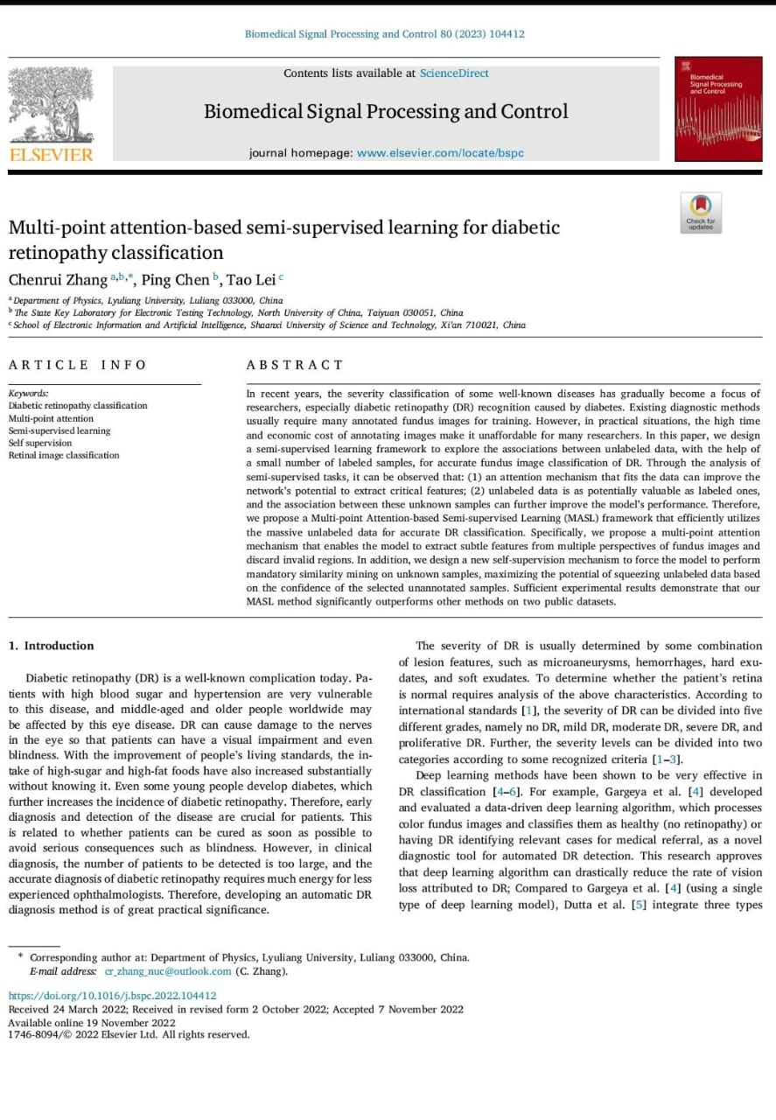
BASE PAPER

Slide 6
LITERATURE REVIEW
Title: Development and validation of a deep learning algorithm for detection of diabetic retinopathy in retinal fundus photographs.
Authors: V. Gulshan, L. Peng, M. Coram, M.C. Stumpe, D. Wu, A. Narayanaswamy, S.Venugopalan, K. Widner, T. Madams, J.Cuadros,(2016).
In this study, the authors achieved high accuracy in classifying diabetic retinopathy severity.

Slide 7
Title: Deep learning for automated diabetic retinopathy Detection.
Authors: Abramoff, M. D., Lou, Y., Erginay, A., Clarida, W., Amelon, R., Folk, J. C., & Niemeijer, M (2016).
This study highlights “the use of deep learning for automated diabetic retinopathy detection and the potential for integration into clinical practice.”

Slide 8
Title: Feedback on a publicly distributed image database: the Messidor database
Authors: Decencies, E., Zhang, X., Cazuguel, G., Lay, B., Cochener, B., Trone (2014).
The Messidor database is widely used resource for diabetic retinopathy research. These studies describe the database and its importance for developing an algorithm approach and its evaluation.

Slide 9
Title: A real-time diabetic retinopathy screening using deep convolutional neural Networks.
Authors: Rajalakshmi, R., Subashini, P., Ramachandran, K., & Warkad (2017).
It has identified and highlighted “ the potential on practical applications and thus significant improvement importance of speed in clinical settings.”

Slide 10
Title: A machine vision system for screening of proliferative diabetic retinopathy.
Authors: Osareh , A., Mirmehdi ,& Thomas (2009).
This earlier study presents a machine vision system for screening proliferative diabetic retinopathy, emphasizing the potential of computer vision techniques

Slide 11
EXISTING SYSTEM
The ETDRS (Early Treatment Diabetic Retinopathy Study) algorithm is a widely used method for assessing diabetic retinopathy severity. It's a clinical grading system that evaluates retinopathy levels based on fundus photographs.
Here are the key components of the ETDRS grading system:
1. Grading of Retinopathy Severity:The grading system is used to monitor the progression of retinopathy and to determine the need for treatment. Early detection and treatment of retinopathy can help prevent vision loss.

Slide 12
2. Macular Edema: Defined based on the presence of retinal thickening and hard exudates in the macula, which can threaten vision. Clinically Significant Macular Edema (CSME): Specific criteria used to determine the presence of edema that is close to the center of the macula and likely to impact vision.
3. Photographic Fields: The ETDRS grading is based on standardized seven-field stereo fundus photographs. These images capture different regions of the retina for accurate assessment of the severity of the disease.

Slide 13
4. Risk Stratification: Based on the findings from the photographs, the ETDRS algorithm provides a framework for predicting the likelihood of progression to severe retinopathy or vision-threatening complications.
5. Use in Treatment Decisions: The ETDRS findings guide decisions on whether to initiate treatment, such as laser photocoagulation or anti-VEGF injections, to prevent vision loss. For instance, laser treatment is recommended for eyes with high-risk PDR or CSME

Slide 14
DRAWBACKS
Hard to Understand
Not Very Accurate
No Clear Pictures
Can't Predict Well
Requires expertise in retinal imaging
May not detect early or subtle change

Slide 15
PROBLEM STATEMENT
To propose a model that will help doctors and patients to easily detect the diabetic retinopathy at early stages using multi-point attention and semi-supervised learning.To propose a model with the high-rate accuracy.

Slide 16
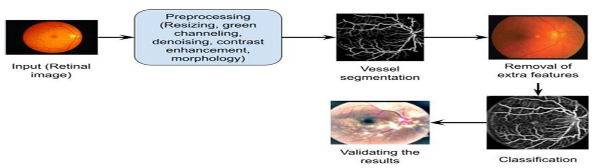
PROPOSED SYSTEM
The proposed method combines multi-point attention mechanism with semi-supervised learning for diabetic retinopathy classification. The model is trained on a combination of labeled and unlabeled data using a semi-supervised learning approach.

Slide 17
OBJECTIVES
1. Improve Accuracy: Develop a deep learning model that accurately classifies Diabetic Retinopathy (DR) stages with an accuracy rate higher.
2. Enhance Robustness: Design a multi-point attention mechanism to focus on relevant regions of retinal fundus images, improving model robustness.
3. Reduce Labeled Data: Investigate semi-supervised learning techniques to reduce labeled data requirements by 30% while maintaining high accuracy.
4. Increase Efficiency: Optimize the model for faster processing times, enabling real-time DR classification
5. Improve Interpretability: Develop visualization tools to explain attention-based model decisions, enhancing model transparency.

Slide 18
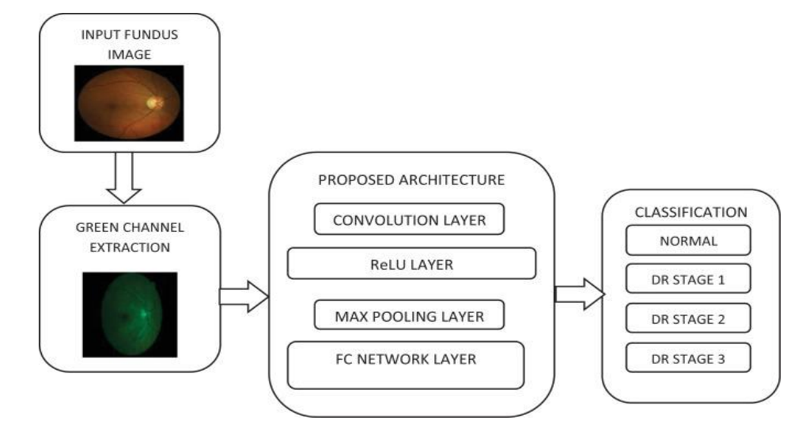
ARCHITECTURE

Slide 19
SOFTWARE AND HARDWARE REQUIREMENTS
Software Requirements:
Operating System : Windows7
Coding Language : PYTHON
Software used : JUPYTER
Hardware Requirements:
System : Pentium IV 2.4 GHz
Hard Disk : 1 TB
Monitor : 14 inches
RAM : 4GB

Slide 20
MODULES
Data Collection and Preprocessing: Gather a dataset of retinal images, ideally labeled for diabetic retinopathy severity. Preprocess the images to standardize their size, contrast, and other relevant factors.
Data splitting: Divide the dataset into three subsets: a labeled training set ,a labeled validation set, and an unlabeled dataset
Data Augmentation: Apply data augmentation techniques to increase the diversity of your dataset, which can help improve model generalization.
Base Convolutional Neural Networks(CNN):Integrate a multipoint attention mechanism into your CNN architecture

Slide 21
Self-training or Pseudo-labeling: Utilize your trained base model to make predictions on the unlabeled data. Assign pseudo-labels to the unlabeled data based on these predictions. Combine the labeled dataset and pseudo-labeled dataset for further training
Evaluation: Use appropriate evaluation metrics (e.g., accuracy, precision, recall, F1-score) to assess the model's performance on a separate test set or through cross-validation.

Slide 22
SYSTEM DESIGN
Data flow Diagram
Class Diagram
Sequence Diagram
Collaboration Diagram
Use case Diagram
Activity Diagram

Slide 23
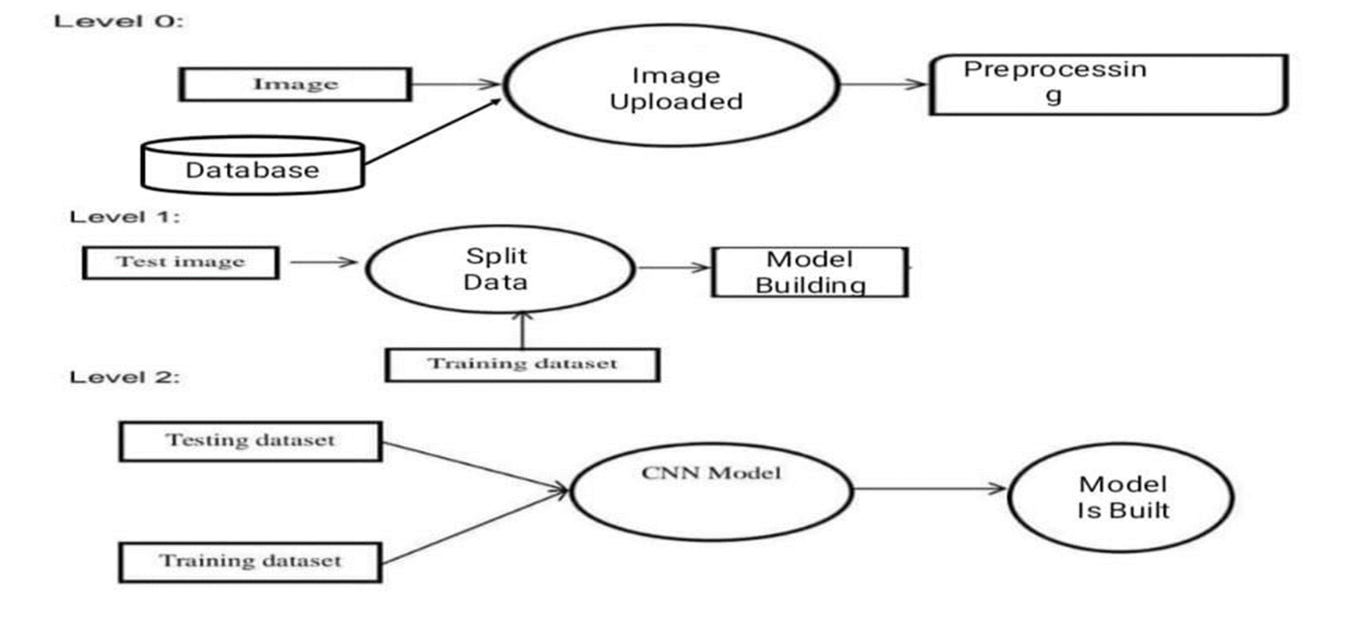
Data flow Diagram

Slide 24
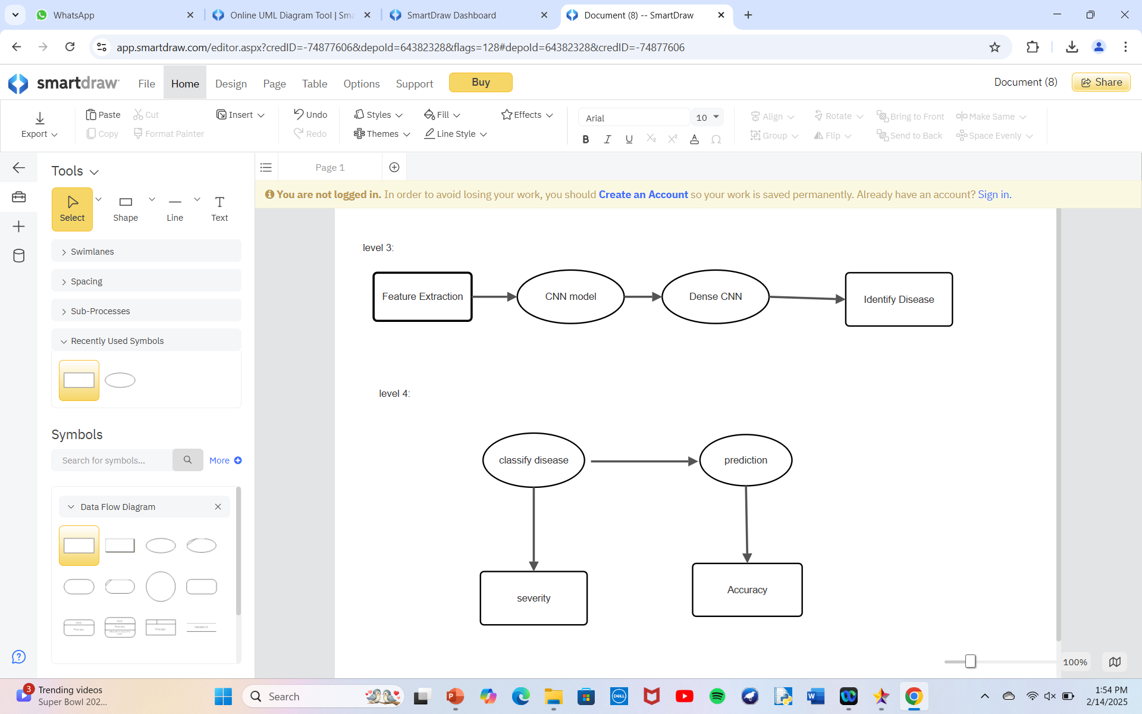

Slide 25
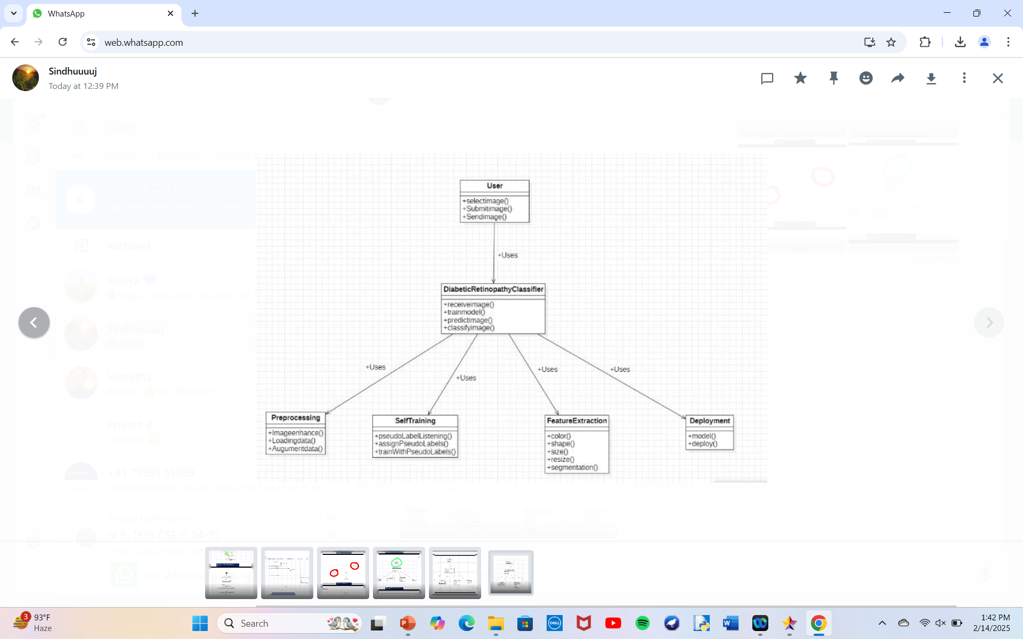
Class Diagram

Slide 26
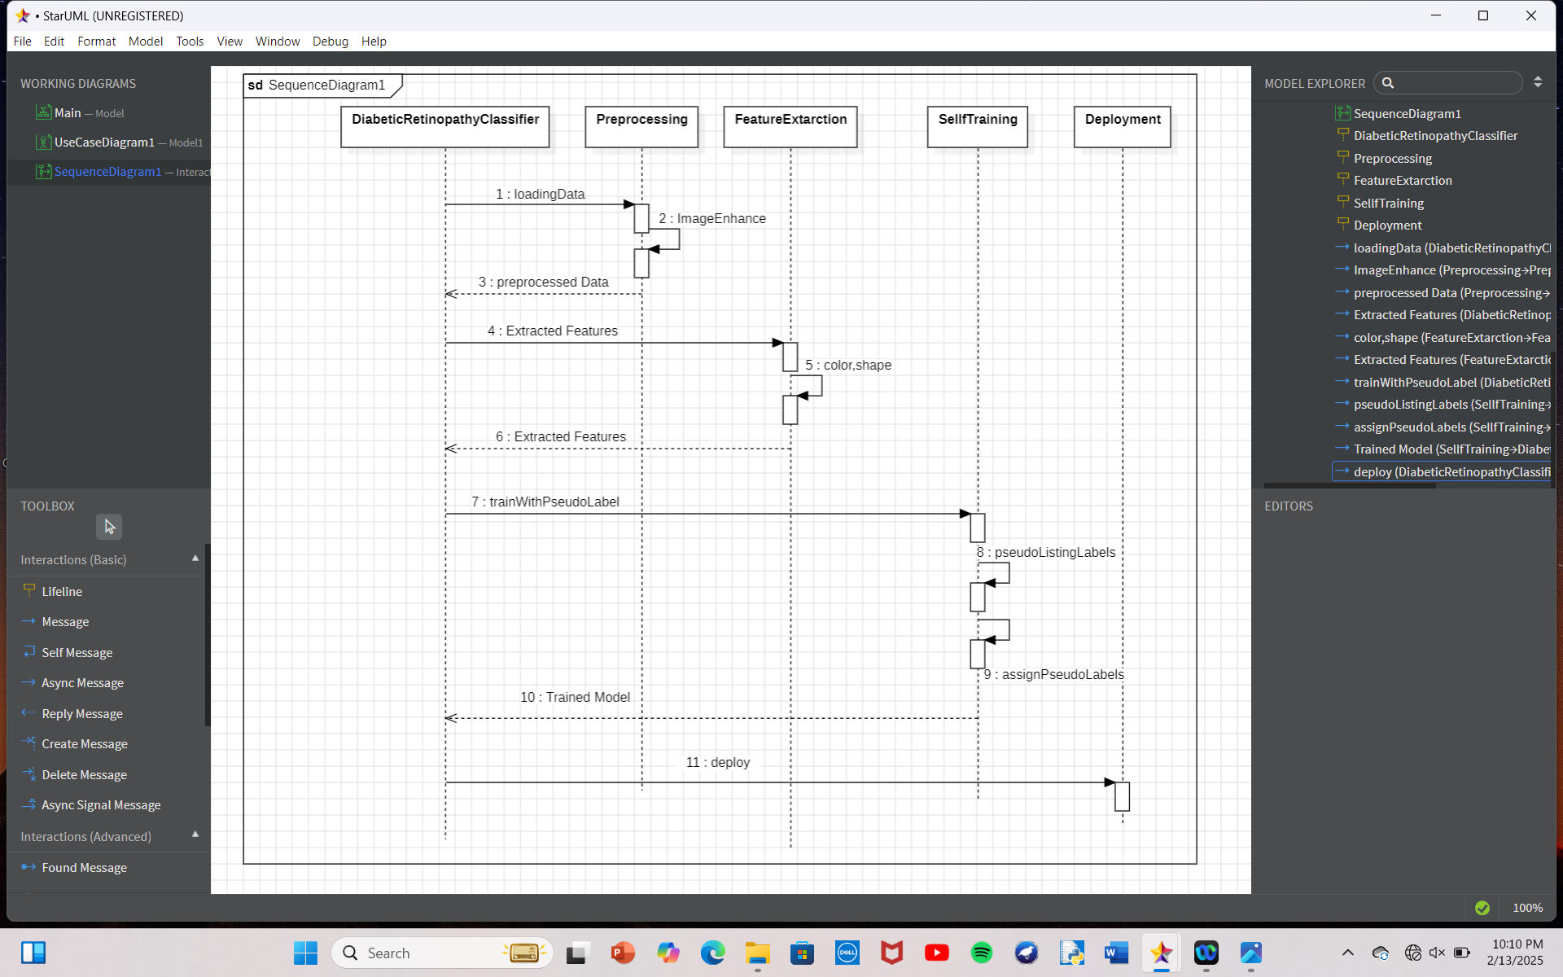
Sequence Diagram

Slide 27
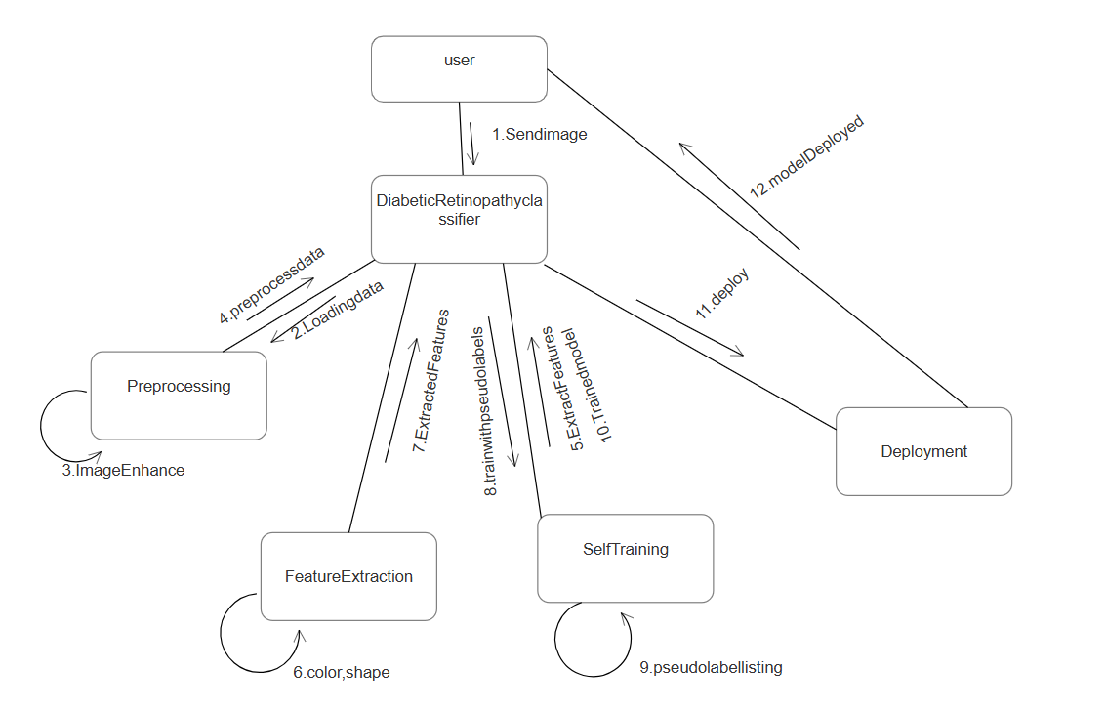
Collaboration Diagram

Slide 28
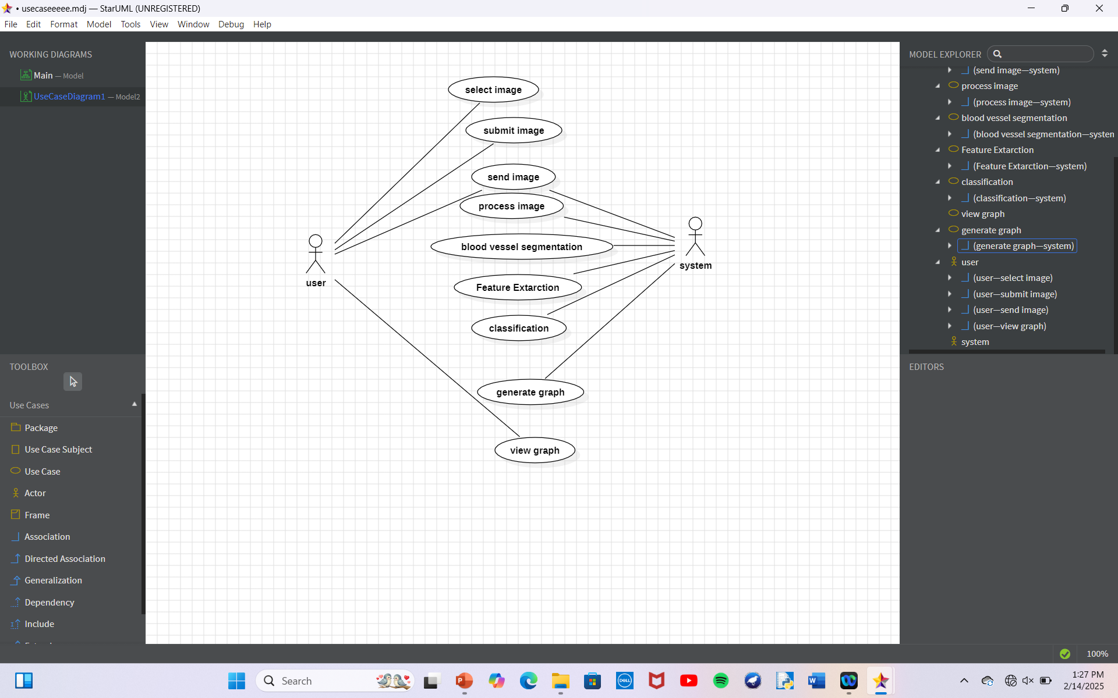
Use case Diagram

Slide 29
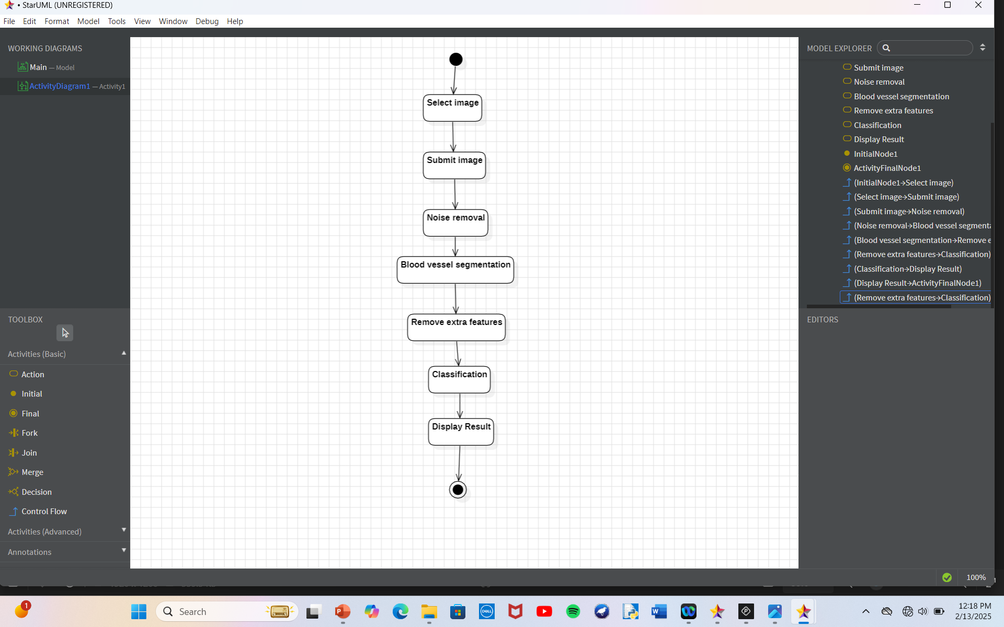
Activity Diagram

Slide 30
REFERENCES
[1]. Multi-point Attention-Based Semi-Supervised Learning for Diabetic Retinopathy Classification Chenrui Zhang a, b, Department of Physics, Lyuliang University, Luliang 033000, China, Ping Chen b, The State Key Laboratory for Electronic Testing Technology, North University of China, Taiyuan 030051, China, Tao Lei c, School of Electronic Information and Artificial Intelligence, Shaanxi University of Science and Technology, Xi’an 710021, China. Journal homepage: www.elsevier.com/locate/bspc
[2]. Gulshan, V., Peng, L., Coram, M., Stumpe, M. C., Wu, D., Narayanaswamy, A.,& Webster, D. R. “A deep learning algorithm for detection of diabetic retinopathy in retinal fundus photographs.”, 2016.
[3]. Abramoff, M. D., Lou, Y., Erginay, A., Clarida, W., Amelon, R., Folk, J. C., & Niemeijer, M., “Deep learning for automated diabetic retinopathy Detection” 2016.

Slide 31


